Slide 1
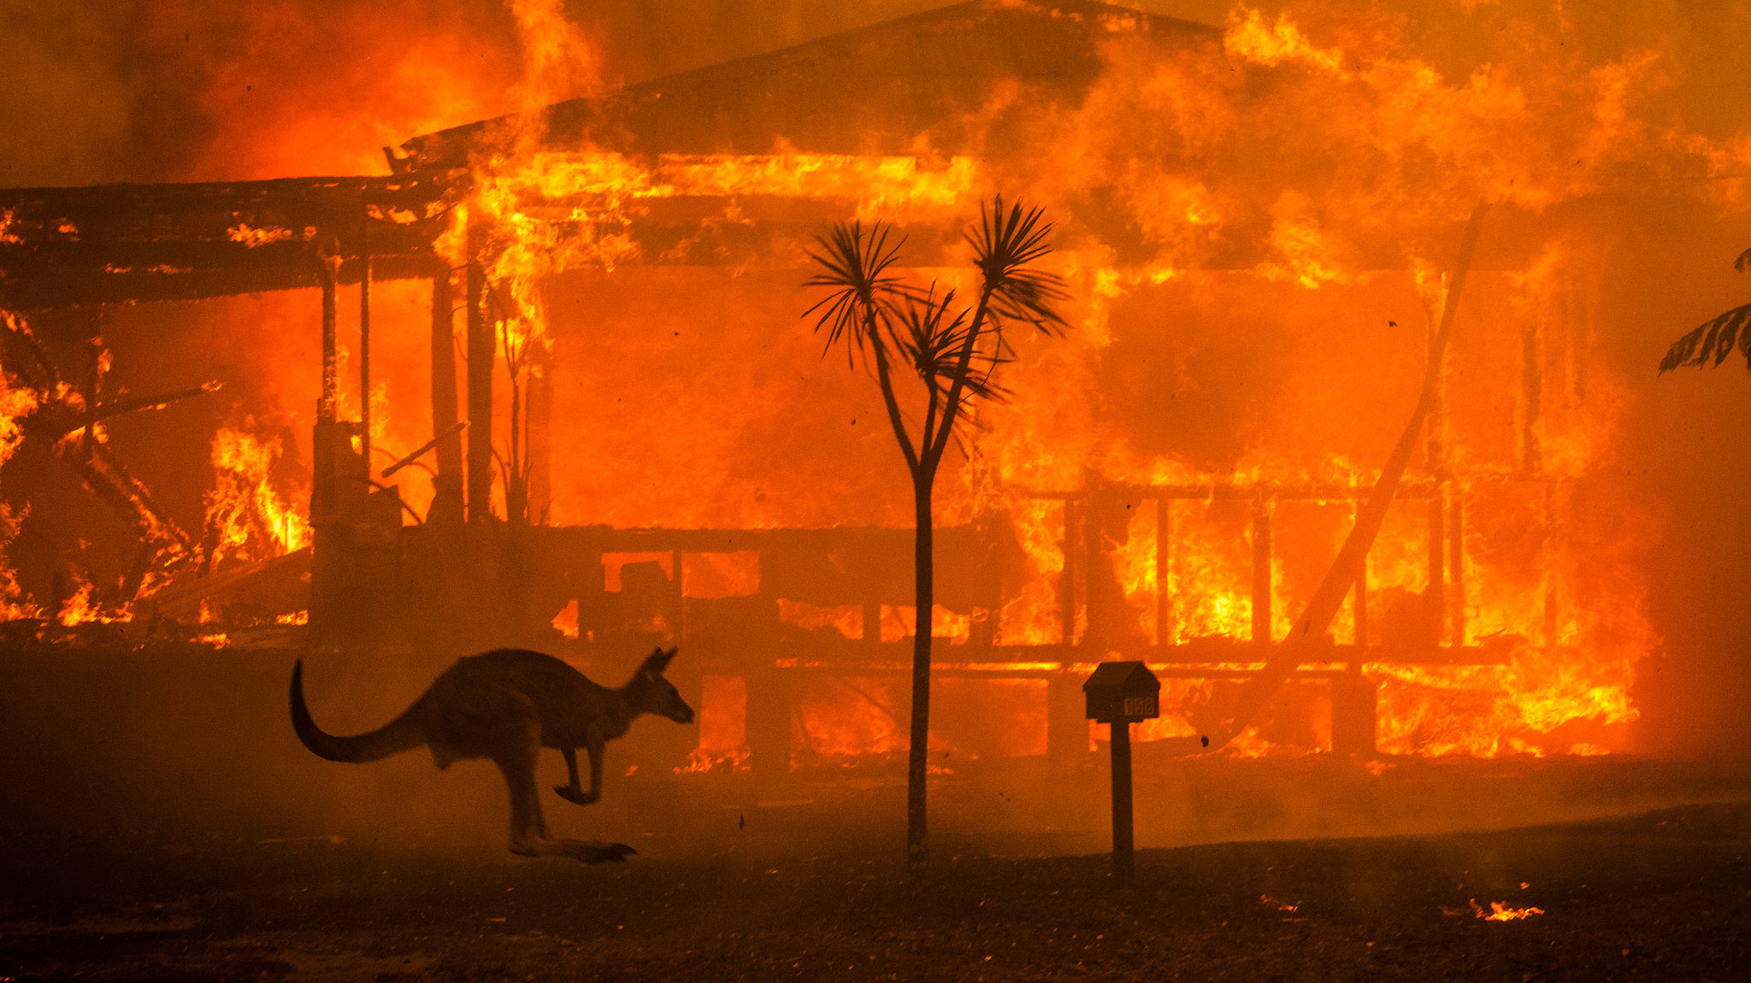
EMERGENCY MANAGEMENT
Australian Bushfires & Ambulance

Slide 2
Demo Slide: Feature/task completed in this iteration
Use the slide to show / discuss:
How and who achieved the task
How this feature/task contribute to the overall project
Live demonstration or a video (preferred)
Challenges you faced and how you overcame them
Demonstrate or otherwise show the feature in operation
Max Time Limit: 8 minutes (for all the demo slides)

Slide 3
Team Contribution
Team Member | Major Contribution(s) | Hours Recorded
Pavan Vadla | Data Sourcing, Visualization of Ambulance Victoria Data, Predicting future Emergency Requirements and final documentation.
Nikita Shishupal Dighe | Mentoring and Managing, Distribution of tasks, Data Sourcing, Preparing User Interface, Creation of database, Planning and execution of UI, Presenting the presentation | 103
Aiswaraya Subrahmanian | Data sourcing for bushfire and weather data. Created heat maps for data. Did reverse geocoding for the bushfire data.
Vijay bathini | Data souring, making presentations and Data Cleaning
Bala Tharun Reddy Shymala | Data Sourcing for Bushfire, Data Cleaning, extraction of weather data in respective with the bushfire locations
Simran Rashpal Dhillon | Planning of UI design, Wireframe representation, Implementation and Execution of UI
The squad worklog should be open for the panel to check
Max Time Limit: 1 minute

Slide 4
Team Contribution
Team Members | Major Contribution(s) | Hours Recorded
Mohan Kiran Bandaru | Visualization using Tableau and Python( time series for Canberra) Data sourcing for bushfire locations Documentation and it is showcased in folder "Mohan"
Hamza Zulfiqar | Data extraction for the bushfires, got familiar with python for my part in Iteration 2, learnt how to plot graphs and visualize data in python
Shikhar Dhyani | Data sourcing, documentation of presentations, upskilling in python, using python to create graphs for data analysis.
Piyush Gandhi | Data Sourcing, Analysis and Visualization of Ambulance Victoria Data, Predicting future Emergency Requirements.
Nithin Reddy Gundre | Data Sourcing, Extracting weather data, Visualisation, Documentation of UI (prototype), prediction analysis | 74
Nikhil Reddy Viraati | Data Sourcing, Data visualization, Working on the previous year's project Ambulance Data, Extracting Weather data relevant to the Bushfire Data.
Varsha Shankar | Data Sourcing, Document presentation, Prediction models and I'm currently working on database creation of bushfire data .

Slide 5
Plan for the next iteration
Max Time Limit: 2 minutes

Slide 6
Discussions with High-Distinction and Distinction Students
Max Time Limit: 5 minutes

Slide 7
General Discussions
Max Time Limit: 10 minutes

